Slide 1

Development of machine learning models to process Electronic Health Records – Imputation Strategies
Week 19 Meeting, 27/2/2021

Slide 2
Introduction
Motivation
Aims
Background
What is Electronic health records
Why is it important
Why doing machine learning
Missing data (collected not through controlled envioronment)
Missing completely at Random (MCAR)
Missing at Random
Missing not at Random (MRAR)
Structurally missing
What other people have done for imputation for clinical Datasets
Compare what have been done

Slide 3
Analysis/Requirements (Configuration)
Research questions (elaborate)
Clinically relevant questions
Define clinical outcomes
Ethics on publicly available data
Installing the MIMIC-III data
Ethics course
Postre-SQL local database
Experiment environment
Installing packages
Design (Processing Pipeline)
About the MIMIC dataset
Patients Data
Events Data
Time-series Data
Ethics and Conduct
Cohort selection
Extraction SQL
Preprocessing
Unit conversion
Removing outliers
Data Aggregation
Reshaping Data
Standardizing
One-hot encoding Categorial variables
Principle Component Analysis/ Recursive feature elimination

Slide 4
Implementation/ Imputation Strategies
Preprocessing
Unit conversion
Removing outliers
Data Aggregation
Reshaping Data
Standardizing
One-hot encoding Categorial variables
Principle Component Analysis/ Recursive feature elimination
Statistical Imputation
Mean imputation
Joint imputation
Machine Learning Imputation
Iterative imputation
KNN imputation
MICE imputation
Deep Learning Imputation
MIDAS imputation
Design (Processing Pipeline)
About the MIMIC dataset
Patients Data
Events Data
Time-series Data
Mortality as a clinical outcome
Cohort selection
Extraction SQL
High level description of implementation

Slide 5
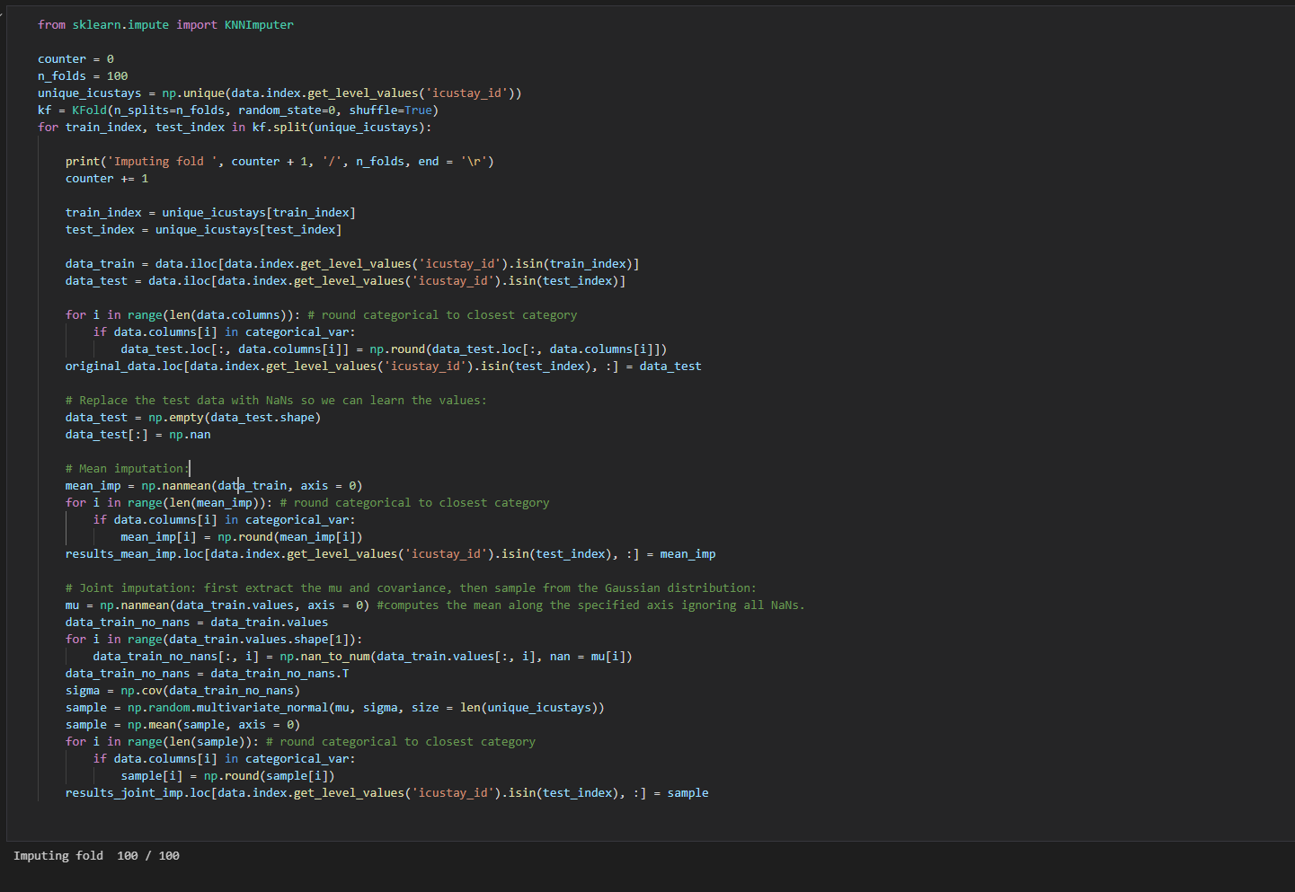

Slide 6
6. Evaluation
Raw bias
Use python to call R
Coverage rate
Average width
Root mean squared Error
Distribution/ Maximum distance
Classification performance
Nemenyi test
Effects of different preprocessing method
Results
Summary
7. Conclusion
Summary
Future work
Appendix
Ex. Distribution graphs

Slide 7
Methods and background (prioritise)
Results, evaluation
Introduction, conclusion towards to end

Slide 8
T-test
Limitations
Multiple comparison correction
Ex. If distribution different from gaussian

Slide 9
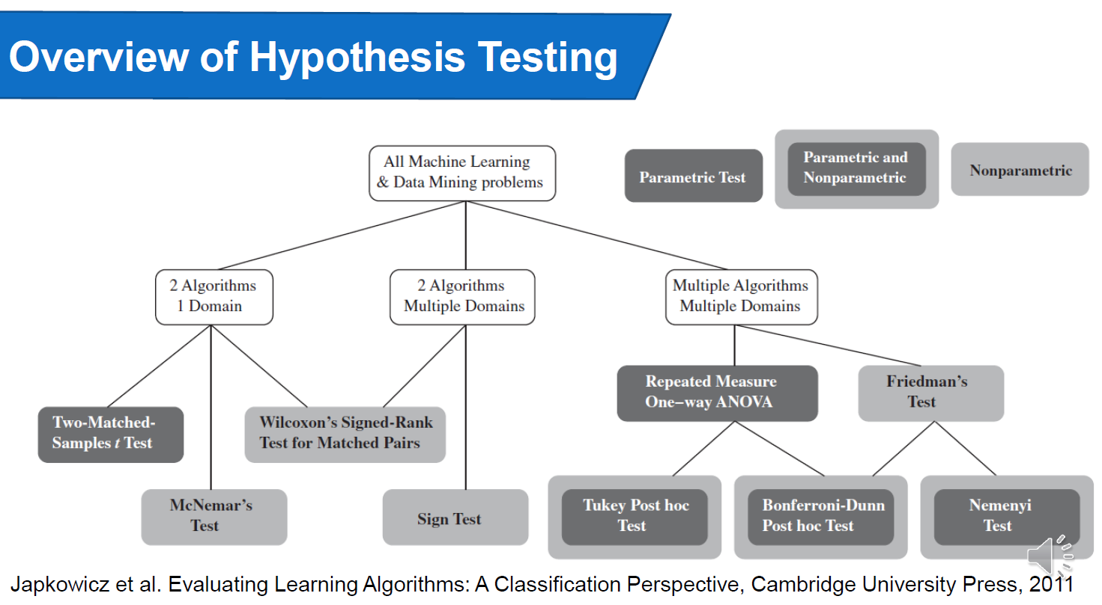

Slide 10
Nemenyi test
Look at the limitations of other hypothesis testing methods
Ex. Multiple algorithms so not suitable for sign test
Parametric non-parametric

Slide 11
